Slide 1


Silicon Rush
Final Pitch
Team Gnome!
Akash Kamlesh PES1UG21CS056 Aditya D Venkatesh Prasanna PES1UG21CS043
Ashwin Bhat PES1UG21CS121

Slide 2
Problem Statement
Track: G-KnowMe
The digital era has become more of a norm than ever before, pushed further by the pandemic. Digital records of health reports enable an efficient tracking of medical history with ease allowing access anytime and anywhere, both for the individuals and medical professionals. Analysis of test results and data collection is faster if the medical records are digitized and tracked over a period of time.

Slide 3
Introduction
Digitalising patient health records Is the need of the hours.
Health records may be from several different sources may be present in several different formats.
This makes it harder for an organization wanting to aggregate these reports in a uniform manner to perform further operations. To add to this problem, Most patients have their records either in the form of a scanned copy or a physical copy.
That is where we step in. Our solution employs Machine learning, image manipulation and database technologies to simplify the process of collecting and preparing reports from patients in a standardised manner, Allowing for further applications.

Slide 4
Approach
Begin with intake of image from the user, through a web application
Apply cropping to the report Image to prepare it for the Machine Learning model
Feed the ML Model with the report Image
Clean the output from the model, to extract relevant information
Store the extracted information into a database
Setup a mechanism to display the extracted details to the patient / user

Slide 5
Milestones
01
02
03
04
05
Feed Image into model
Relevant Data Extraction
Image Intake & processing
Implemented a web interface to intake the image and apply auto cropping
Image successfully fed into the model
Text output received
Output from the model cleaned and only relevant info extracted
Send & Store data into database
Record Retrieval
Cleaned data successfully sent and stored into a database
Stored patient reports retrieved and presented to user on the web application

Slide 6
System Workflow & Tech Stack
Accept report from user via website
Pass edited image into model for Optical Character Recognition
(utilising EasyOCR)
Crop Image using Cloudinary Libraries
Allow User to retrieve report data from database and present it on the website.
Export extracted data & store in database, report wise.
(using MongoDB)
Filter text output from model to extract relevant information using python

Slide 7
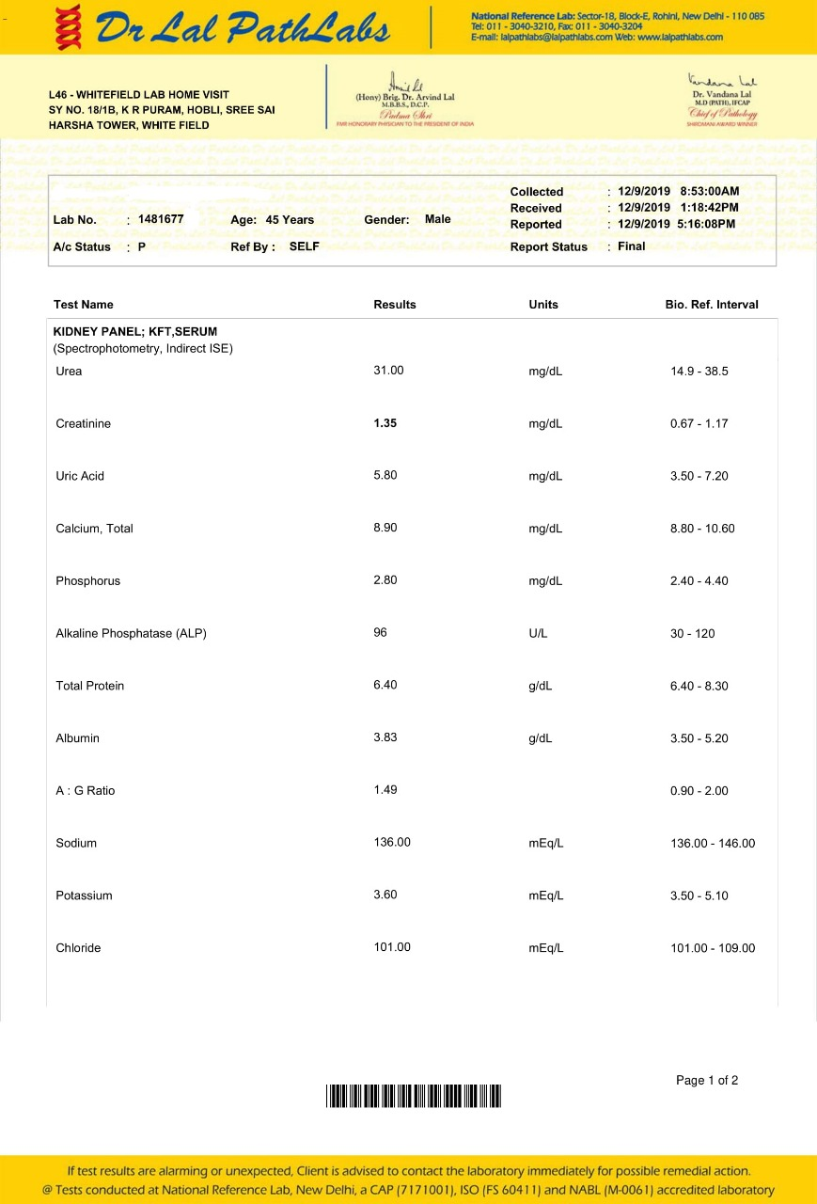
Sample Report taken as input

Slide 8
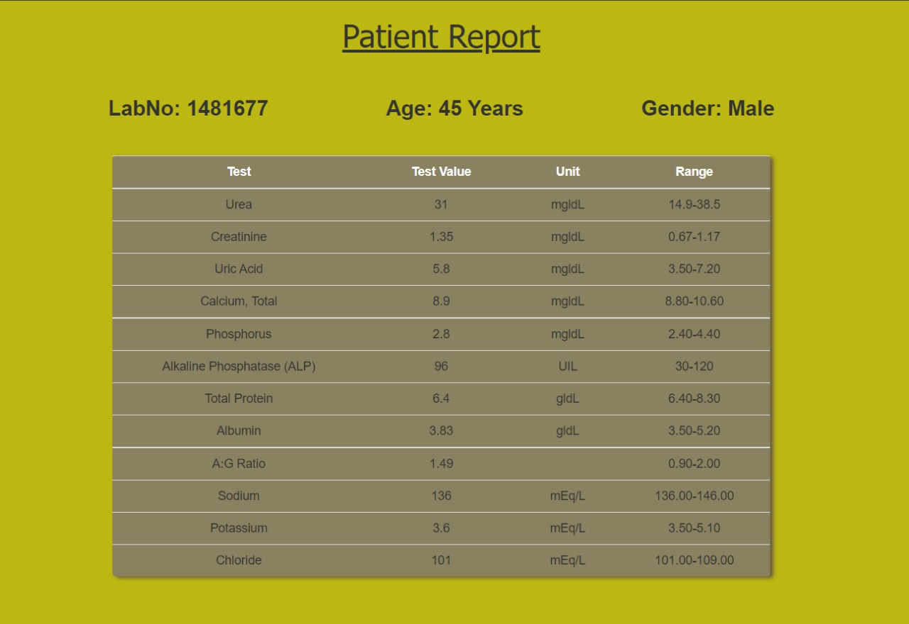
Output Displayed To User

Slide 9
Challenges
Ensuring a consistent auto cropped image output for a variety of reports
Effective text filtering as different reports utilise different keywords.

Slide 10
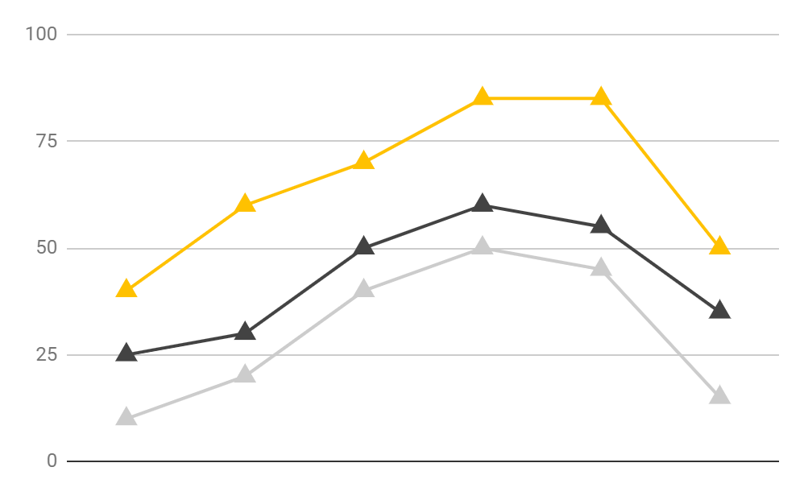
Our USP
Medical Institution/Lab
Corporate, Universities
For government organizations/ health schemes /NGOs
Digitalizing health records (old, handwritten, hardcopies). Aggregation of reports from various medical labs/hospitals.
The product is cloud-based and inexpensive start out, it can be easily upgraded as per the client’s requirements.
Our solution is highly accurate.
The x-ray feature can save the patient and doctor time by feeding the image to the model and getting instant results.
Our product is easily scalable and simple to use.

Slide 11
Future Scope
The applications when it comes to machine learning models are endless.
Currently we are working on implementing a service where a user can upload their chest X-Rays to get a preliminary result on if a Pneumonia or Covid infection is present.
Test Data is promising! Our test model has achieved high accuracy when it comes to detecting the above mentioned illnesses.
A service like this can be continually improved by feeding more data. It would prove extremely useful to doctors and lab technicians in quickly filtering patient cases so that they can focus on the patients that need immediate attention.

Slide 12
Thank you :)
BIBLIOGRAPHY
C. Kaundilya, D. Chawla and Y. Chopra, "Automated Text Extraction from Images using OCR System," 2019 6th International Conference on Computing for Sustainable Global Development (INDIACom), 2019, pp. 145-150.
M. Gorai and M. J. Nene, "Layout and Text Extraction from Document Images using Neural Networks," 2020 5th International Conference on Communication and Electronics Systems (ICCES), 2020, pp. 1107-1112, doi: 10.1109/ICCES48766.2020.9137859.

